Slide 1
Track Time™©
Driver database and track time analyzer
Steven An
Tim Bly
Amar Jandu

Slide 2
Racer Class (Our Primary Data Type)
Name (Used as BST Key)
licenseID (Used as HASH Key)
Circuit Name
Date Lap was driven
Laptime in Seconds
Example of displaying a racer:
Delia Garbacea C1234567 De Anza Circuit 12/4/14 123.4

Slide 3
Data Structure Diagrams (Hash Table)
HashDictionary* racerDict
int itemCount
Int hashTableSize
HashDictionaryElement* hashTable
int count
LinkedList* LLArr
int count
LinkedList* LLArr
int count
LinkedList* LLArr
…
…
…
head
racer1

Slide 4
Data Structure Diagrams (Binary Search Tree)
BST* racerTree
int itemCount
BSTnode* root
ItemType item
BSTnode* left
BSTnode* right
racer2
racer1
racer3

Slide 5
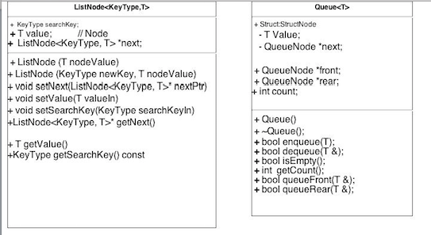
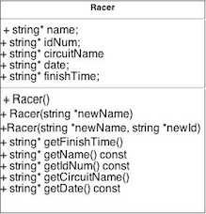

Slide 6
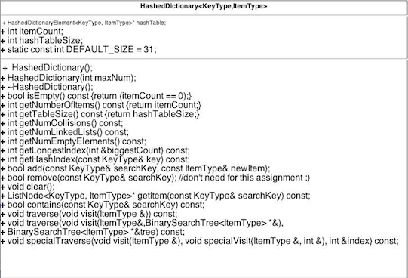

Slide 7
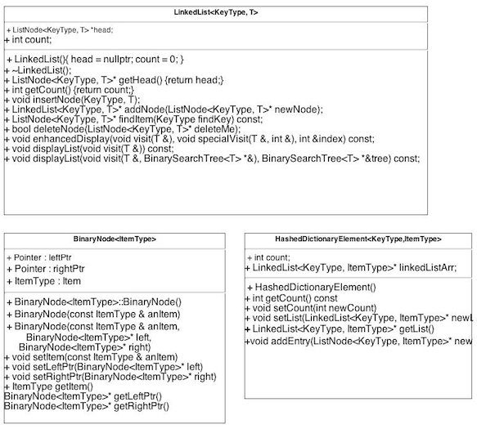

Slide 8
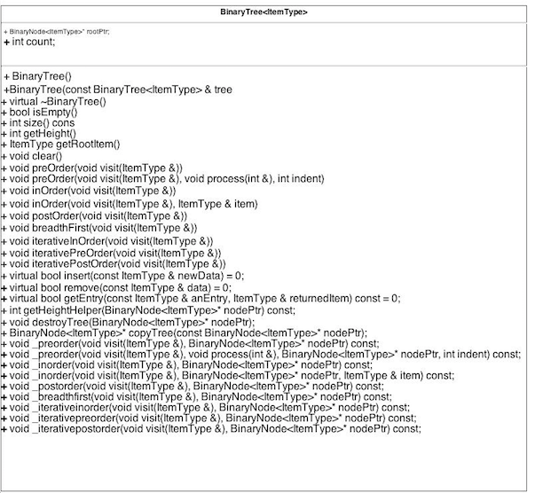

Slide 9
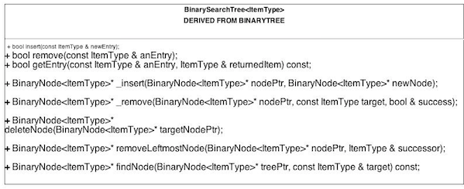

Slide 10
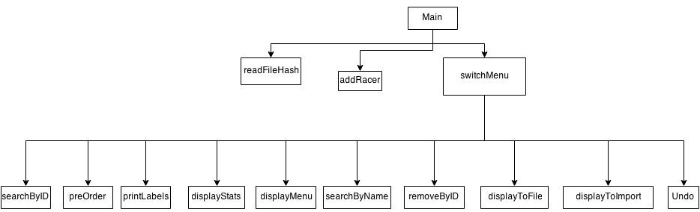
Main control structure

Slide 11
Hash Function
template<class KeyType, class ItemType>
int HashedDictionary<KeyType, ItemType>::getHashIndex(const KeyType& key) const
{
std::tr1::unordered_map<KeyType, ItemType> mapper;
typename std::tr1::unordered_map<KeyType, ItemType>::hasher hashFunction = mapper.hash_function();
return static_cast<int>(hashFunction(key) % hashTableSize);
}
From the book. ☺

Slide 12
Collision Resolution
Linked Lists

Slide 13
Collision Resolution
With 31 spots on the hash table…we had a 67.7% load factor
Results!

